Slide 1

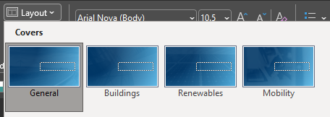

Climate Change Mitigation and Resilience
  STAB Technical Consultant Presentation
Selecting a cover according to focus area
Covers and Section breaks according to our focus Areas are available in the dropdown of the Layout menu
STAB Meeting
March 24, 2026

Slide 2
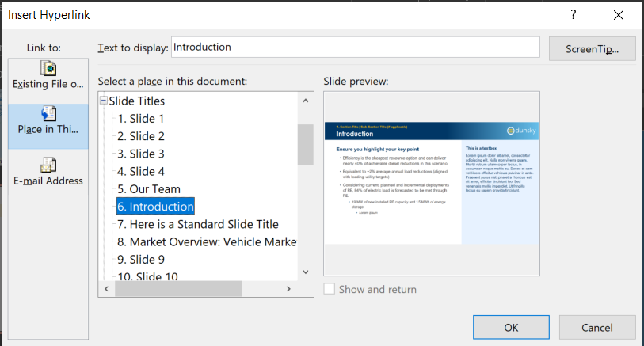
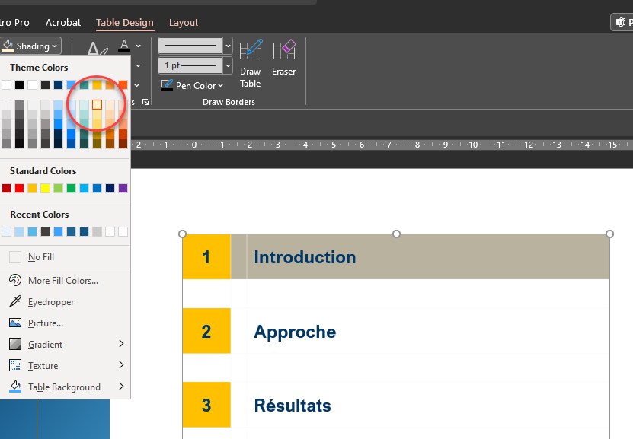
Agenda
How to create an interactive Agenda
Select the TOC item then right-click Link. In the left hand panel, select Place in this document. Select the slide you want to link to and press OK. The agenda item will now be hyperlinked.
1 |  | Resilience Plan Update & Next Steps
2 |  | STAB February Statement Follow-Up
3 |  | 2026 Climate Science Report
4 |  | Student Supported STAB Research
5 |  | C-Team Scope of Work
To add/delete a row
To add, select the table and go to Layout > Insert Below (click twice). Remove shading in the extra row by going to Table Design > Shading > No Fill
To delete, select the rows to remove and go to Layout > Delete > Delete Rows
To highlight a section in the agenda
Top highlight, select the section and go to Table Design > Shading > lightest shade of Yellow (Gold, Accent 4, Lighter 80%). Add bold to the highlighted section.
2

Slide 3
Resilience Plan
Updates
Resilience plan updated after receiving comments from STAB, many other stakeholders
EC4 reviewed & approved the updated, final plan on Friday 3/20
Final copy of plan received by STAB C-Team last week
Next Steps
Does the STAB want a similar ‘transparency record’ of the degree to which comments provided were incorporated into the Final Draft?
  The Consultant, Arup, who presented at EC4 offered to send a summary of how STAB comments were considered, but this has not been received at the time slides were finalized.
Tracking implementation – e.g., funding deployment through RIIB, other channels.

Slide 4
Agenda
How to create an interactive Agenda
Select the TOC item then right-click Link. In the left hand panel, select Place in this document. Select the slide you want to link to and press OK. The agenda item will now be hyperlinked.
1 |  | Resilience Plan Update & Next Steps
2 |  | STAB February Statement Follow-Up
3 |  | 2026 Climate Science Report
4 |  | Student Supported STAB Research
5 |  | C-Team Scope of Work
To add/delete a row
To add, select the table and go to Layout > Insert Below (click twice). Remove shading in the extra row by going to Table Design > Shading > No Fill
To delete, select the rows to remove and go to Layout > Delete > Delete Rows
To highlight a section in the agenda
Top highlight, select the section and go to Table Design > Shading > lightest shade of Yellow (Gold, Accent 4, Lighter 80%). Add bold to the highlighted section.
2

Slide 5
STAB Statement on Climate Strategy + Budget Proposal
Legislative Session Update
Part of the purpose of today’s discussion is to keep the STAB informed of the current discourse related to the topics addressed in the STAB’s statement.
You will hear from STAB member Timmons Roberts, as well as guest speaker, member of the Advisory Board, and Acadia Center employee Emily Koo
Work Plan
C-Team has a work-in-progress on a supporting memo with further evidence to support STAB’s comments
Draft memo planned for April STAB Meeting
This material has already been useful in conversations regarding STAB climate strategy review and current legislative session

Slide 6
Agenda
How to create an interactive Agenda
Select the TOC item then right-click Link. In the left hand panel, select Place in this document. Select the slide you want to link to and press OK. The agenda item will now be hyperlinked.
1 |  | Resilience Plan Update & Next Steps
2 |  | STAB February Statement Follow-Up
3 |  | 2026 Climate Science Report
4 |  | Student Supported STAB Research
5 |  | C-Team Scope of Work
To add/delete a row
To add, select the table and go to Layout > Insert Below (click twice). Remove shading in the extra row by going to Table Design > Shading > No Fill
To delete, select the rows to remove and go to Layout > Delete > Delete Rows
To highlight a section in the agenda
Top highlight, select the section and go to Table Design > Shading > lightest shade of Yellow (Gold, Accent 4, Lighter 80%). Add bold to the highlighted section.
2

Slide 7
STAB Climate Science Report
Purpose and audience for this report
  Prior iteration was very focused on summarizing potential impacts from climate change for Rhode Island (see next slide for outline)
  Will this focus be additive in the same year as the resilience plan? What do members think would be most important/impactful to convey?
Potential themes from STAB work in past ~12 months
  Biofuels’ emissions impacts
  REC accounting moving from annual/anywhere to matching in time and space
  Attribution of impacts in Rhode Island to Climate Change (Superfund Law)
Topics/input from Joe Poccia, RI State Climatologist
  In truth, we will be supporting Joe’s efforts at least as much as vice versa!

Slide 8
Outline of Most Recent Annual Report (2020)
Intro/Overview
Warming Air Temperatures and Policies Needed to Reduce Greenhouse Gas Emissions
Warming Water Temperatures
Sea Level Rise and Need for Longer Term Planning
Storm Frequency and Intensity
Precipitation and Flooding
Changing Biodiversity

Slide 9
Agenda
How to create an interactive Agenda
Select the TOC item then right-click Link. In the left hand panel, select Place in this document. Select the slide you want to link to and press OK. The agenda item will now be hyperlinked.
1 |  | Resilience Plan Update & Next Steps
2 |  | STAB February Statement Follow-Up
3 |  | 2026 Climate Science Report
4 |  | Student Supported STAB Research
5 |  | C-Team Scope of Work
To add/delete a row
To add, select the table and go to Layout > Insert Below (click twice). Remove shading in the extra row by going to Table Design > Shading > No Fill
To delete, select the rows to remove and go to Layout > Delete > Delete Rows
To highlight a section in the agenda
Top highlight, select the section and go to Table Design > Shading > lightest shade of Yellow (Gold, Accent 4, Lighter 80%). Add bold to the highlighted section.
2

Slide 10
STAB Student-Supported Research
Across research efforts, STAB C-Team has provided methodological advice and reference materials to students, primarily through short, targeted meetings (typically no more than 1 hour per week)
Fall 2025: Climate & Clean Energy Legislation in Rhode Island - history & opposition
  Important foundational information for STAB to fulfill statutory role: “Evaluate to what extent the state’s policies and programs aimed at mitigating and adapting to climate change are supported by the best available science and technical information.”
Winter 2026: Transportation Sector Decarbonization opportunities research
  Addressing STAB top-line concern with Climate Strategy’s transportation modeling limitations
Spring 2026: Climate Superfund Legislative Proposal –RI legislators’ request to Timmons
  Opportunity to directly inform the technical basis for an active legislative proposal

Slide 11
Agenda
How to create an interactive Agenda
Select the TOC item then right-click Link. In the left hand panel, select Place in this document. Select the slide you want to link to and press OK. The agenda item will now be hyperlinked.
1 |  | Resilience Plan Update & Next Steps
2 |  | STAB February Statement Follow-Up
3 |  | 2026 Climate Science Report
4 |  | Student Supported STAB Research
5 |  | C-Team Scope of Work
To add/delete a row
To add, select the table and go to Layout > Insert Below (click twice). Remove shading in the extra row by going to Table Design > Shading > No Fill
To delete, select the rows to remove and go to Layout > Delete > Delete Rows
To highlight a section in the agenda
Top highlight, select the section and go to Table Design > Shading > lightest shade of Yellow (Gold, Accent 4, Lighter 80%). Add bold to the highlighted section.
2

Slide 12

Recent and Upcoming Work
Consultant Team Scope of Work
Recent tasks include:
  Support student-led research on several RI climate-related topics
  Comprehensive review of draft Resilient Rhody plan
  Attend EC4 meeting during which Resilient Rhody was adopted
Upcoming tasks include:
  Support STAB review and input regarding technical impacts of near-term climate & energy related policies & actions in RI
  STAB Annual Scientific Report – develop project plan, begin work
  Prepare for STAB Budget request to EC4 – for discussion in future STAB meeting
3

Slide 13

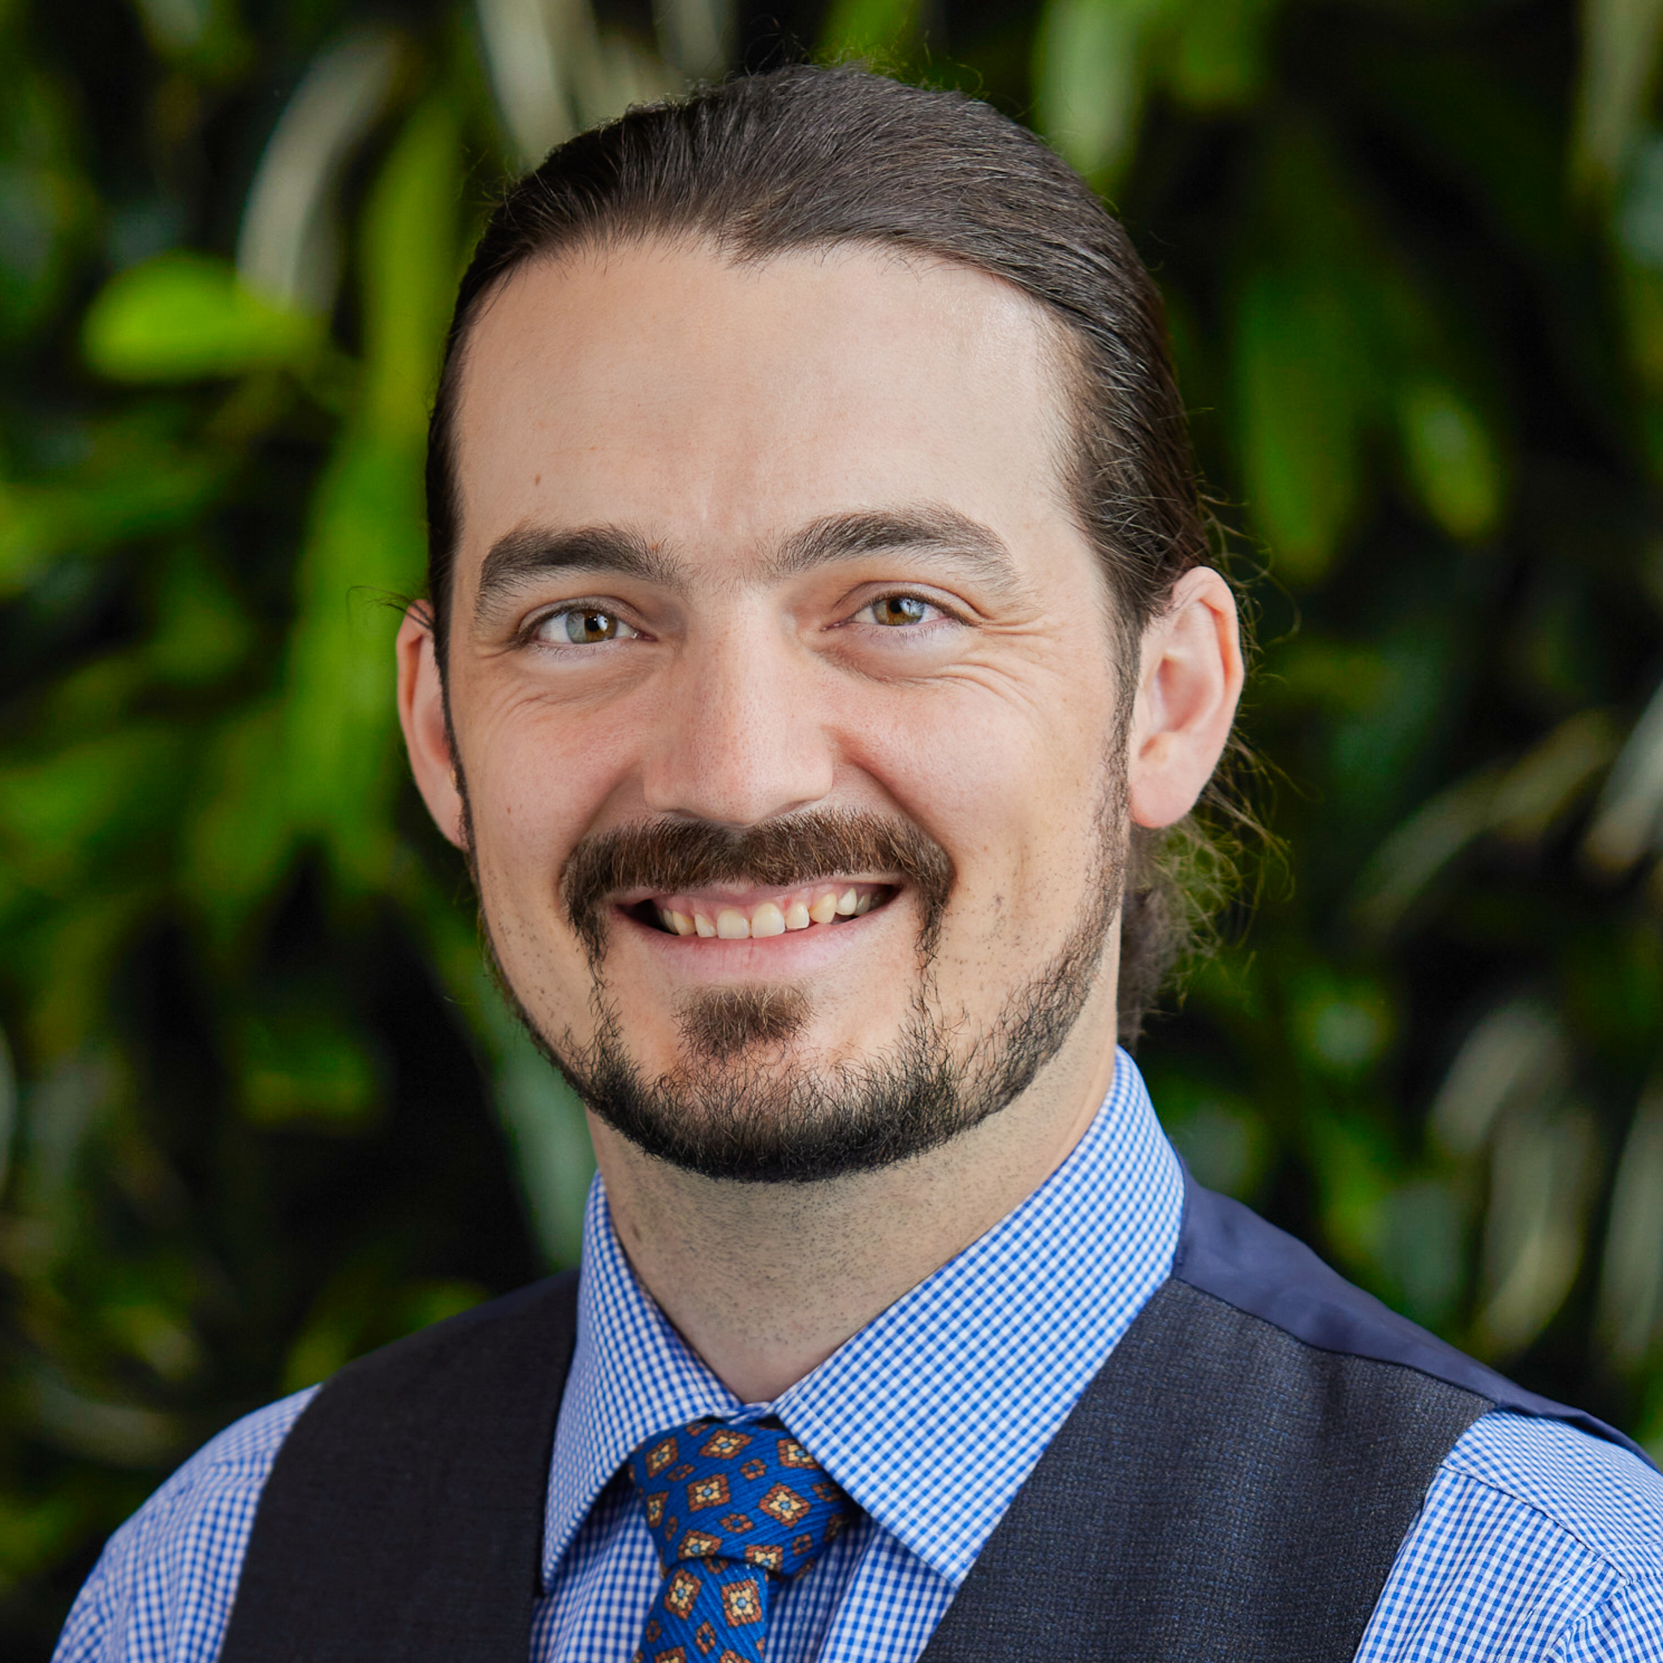
Title and horizontal
yellow line spacing
The space between a yellow line and a title is equivalent to a horizontal,
lowercase d set to Century Gothic Bold and same font size as the title
Questions?
Sam Ross
Director
samuel.ross@dunsky.com
Staff photos
Staff photos are available in the Graphics section below

